Slide 1
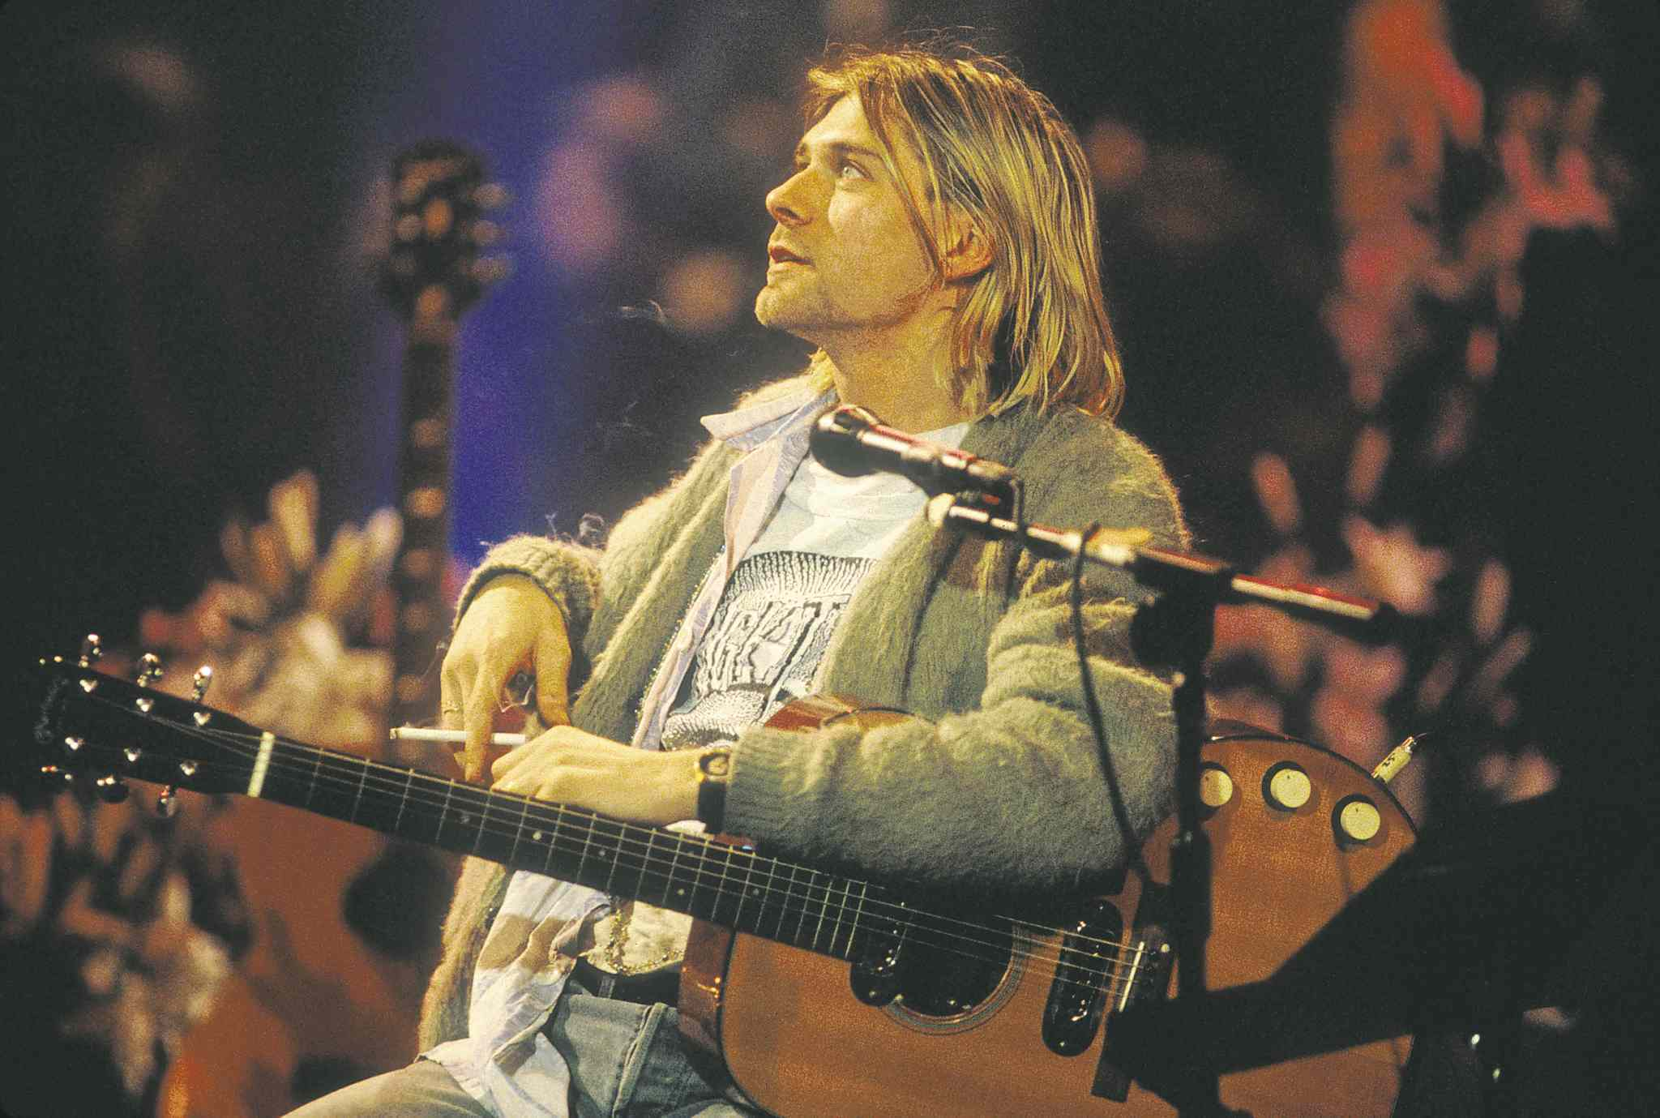
Developing an automatic Machine Learning system for lyric analysis

Slide 2
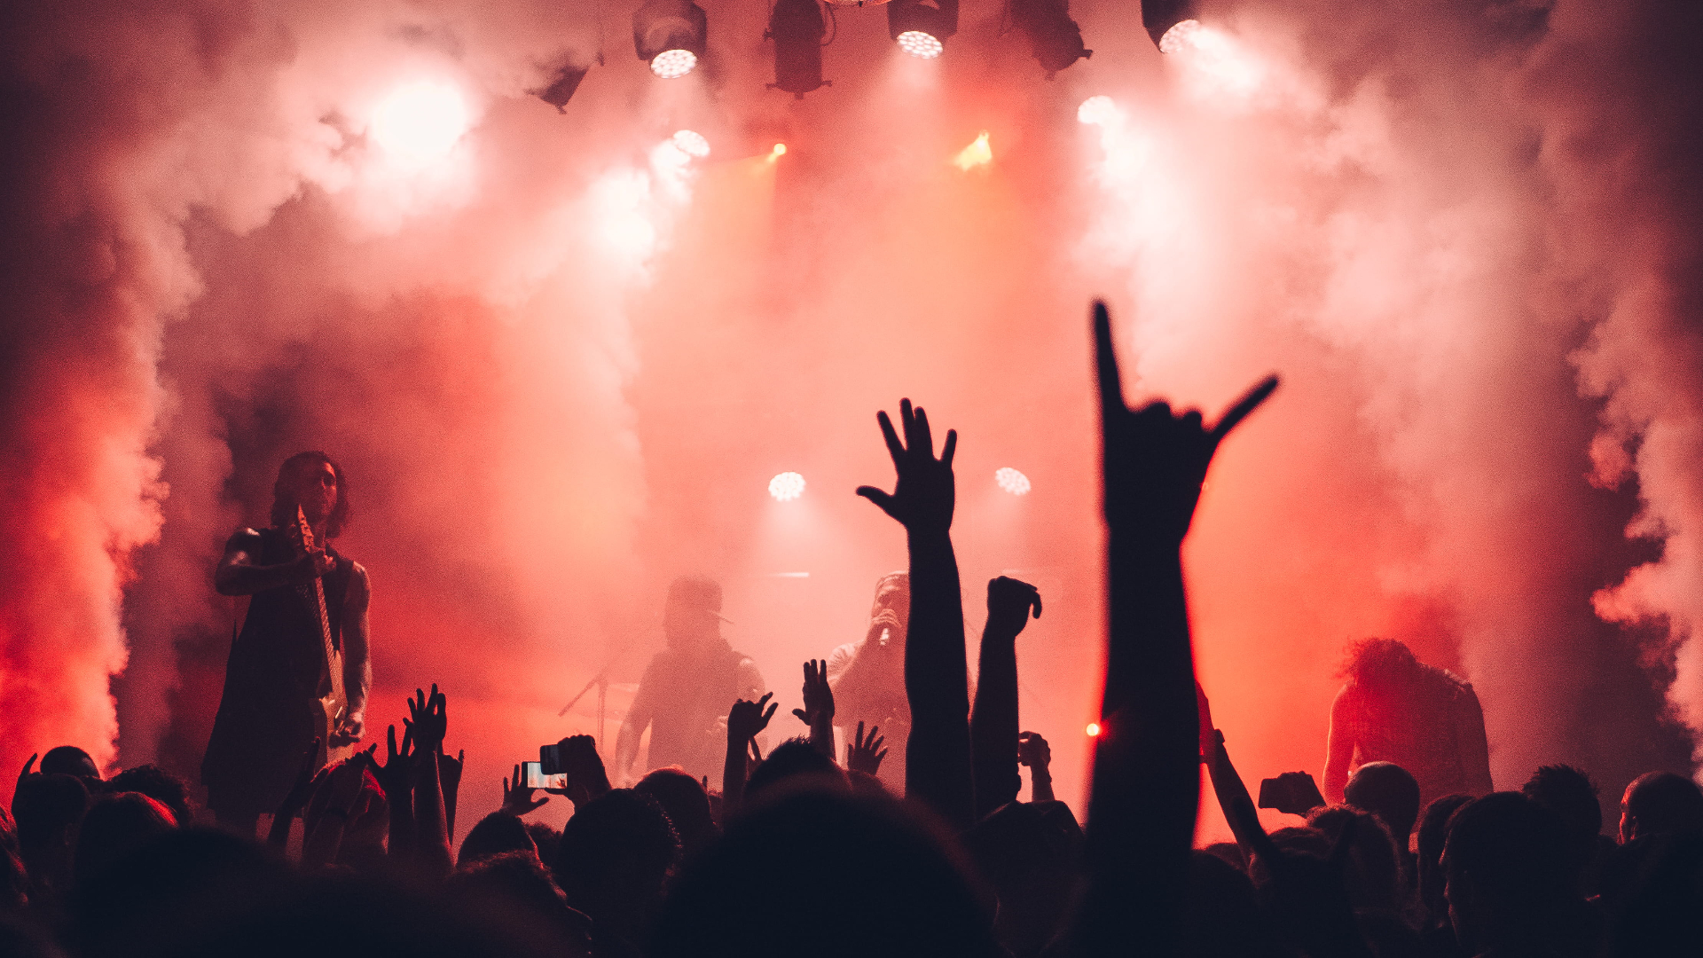
Introduction
Understanding the impact of song lyrics has never been more significant
They have the astonishing ability to tap into our emotions in a way that resonates deeply with us
And the power to touch the hearts of individuals around the world
Notes:
In an era where songs can effortlessly get stuck in our heads and where “waxing lyrical" means to describe with great enthusiasm and eloquence, understanding the impact of song lyrics has never been more significant. It's not just about the beat and melody; it's the words that give music its soul, enabling us to connect, emote, and find meaning in the notes.
Music is often regarded as a universal language. It transcends geographical borders and cultural differences, connecting people across the globe through its emotional and tonal qualities. Now, think of a song that has moved you, perhaps to tears, or to the dancefloor. It's not just the melody; it's the lyrics that create this powerful connection. They have the astonishing ability to tap into our emotions in a way that resonates deeply with us.
While the lyrics of songs may not always be universally understood, the emotions and stories they convey have the power to touch the hearts of individuals around the world. Whether you're in the heart of New York City or the serene Japanese countryside, listening to the strings of a guitar or the rhythmic beating of a drum, the power of lyrical verses unites us all. A song can touch your soul even when you don't understand the words. It's this universal appeal that makes music one of the most potent forms of art.

Slide 3
The goal is to develop a model that can providing a comprehensive fluent understanding of the lyrics of a given song
They are more than just words; they are reflections of the society and culture from which they were born
They narrate tales of love and loss, hope and despair, just as a great book or film can

Slide 4
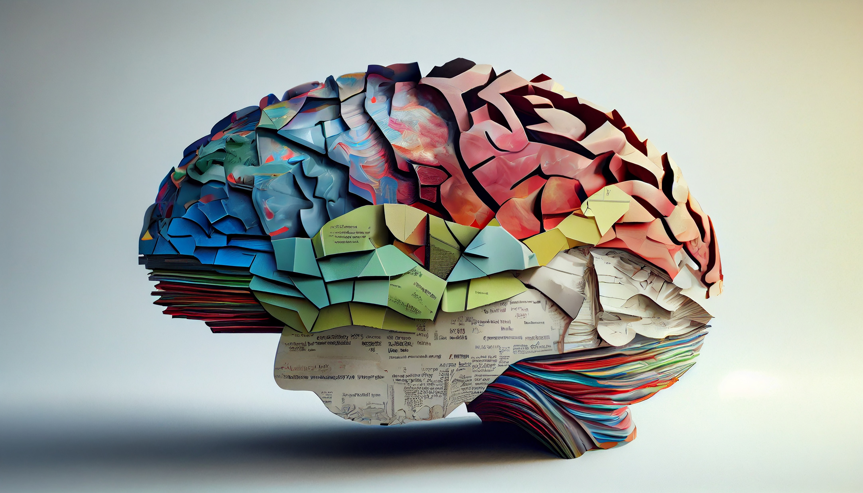


Why is it challenging?

Slide 5
Subjectivity
All forms of art are inherently subjective
Therefore, describing an interpretation “correct” is simply not possible.
But, beneath this subjectivity, there exist common themes and emotions that songs often explore.
Crucial for ML models to grasp

Slide 6
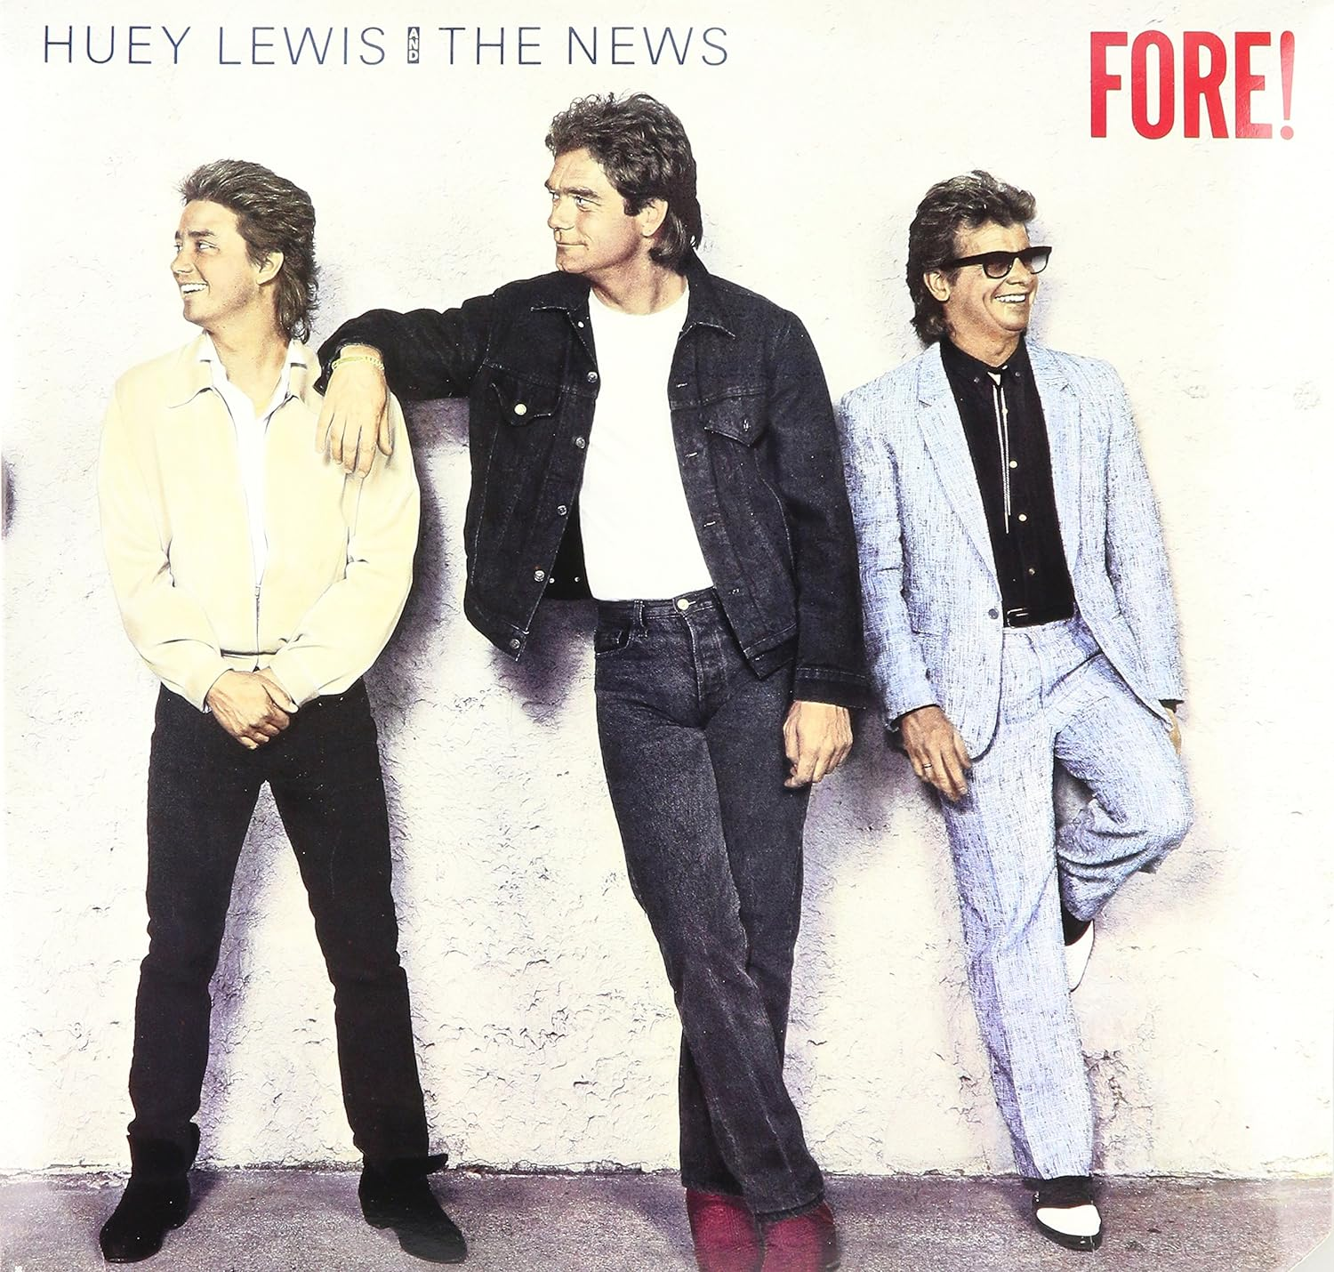
Subjectivity
All forms of art are inherently subjective
Therefore, describing an interpretation “correct” is simply not possible.
But, beneath this subjectivity, there exist common themes and emotions that songs often explore.
Crucial for ML models to grasp
“It’s a curious thing, what makes one man weep, will make another man sing.”

Slide 7
Why is it challenging?

Slide 8
Figurative
Language
Metaphors, symbolism, irony, satire, and poetic language add complexity
Thus, lyrics are not always to be taken at face value.
Machine learning models must struggle with abstract nature of songwriting and to grasp the subtleties of human expression.

Slide 9
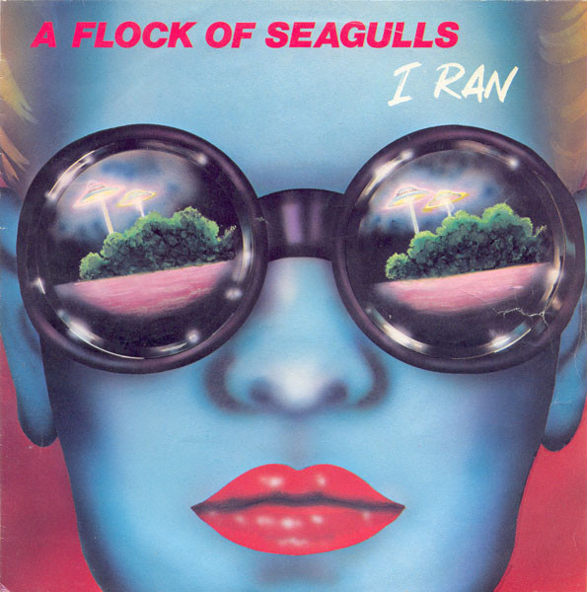
Figurative
Language
Metaphors, symbolism, irony, satire, and poetic language add complexity
Thus, lyrics are not always to be taken at face value.
Machine learning models must struggle with abstract nature of songwriting and to grasp the subtleties of human expression.
“A cloud appears above your head. A beam of light comes shining down on you.”

Slide 10
Why is it challenging?

Slide 11
Artistic
intent
Artists are sometimes intentionally cryptic.
This can range from baking wordplay into the lyrics to the reason for writing the song in the first place.
They can craft cherished melodies, often layered with meaning, even if it was not their aim.

Slide 12

Artistic
intent
Artists are sometimes intentionally cryptic.
This can range from baking wordplay into the lyrics to the reason for writing the song in the first place.
They can craft cherished melodies, often layered with meaning, even if it was not their aim.

Slide 13
Why is it challenging?

Slide 14

How do we go about solving this?
A
literature review

Slide 15
2014
Sequence to Sequence Learning with Neural Networks
Similar to attention in humans
Introduced a novel attention mechanism
It allowed the model to shift its focus on different parts of the input sequence while generating an output sequence
This may be the verses other than the chorus in a song

Slide 16
2017
Attention is all you need
Similar to attention in humans
Introduces the transformer architecture
Also utilizes 2 kinds of attention, self and multi-head
This may be the verses other than the chorus in a song

Slide 17
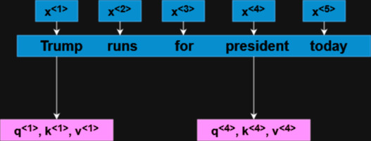

Self-attention refers to calculating a vector representation of each word, in turn making use of 3 other vectors known as query, key and value.
Calculated using :
$A(q,k,v)= \sum_{i}{\frac{exp(q∗k<i>)}{ \sum_{j}{exp(q∗k<j>)}}}$
Intuitively, q represents a question, e.g.: Who is running for president? Then, q^{<3>} * k^{<1>} = “Trump” would be the answer. The highest value of q^{<x>} * k^{<x>} represents the best answer.

Slide 18
These can correspond to asking different questions:
W₁^{Q}, W₁^{K}, W₁^{V} = “What is happening?”
- W₂^{Q}, W₂^{K}, W₂^{V} = “When?”
Multi-head attention simply means that we calculate attention for the same sequence multiple times
Each time, the calculation remains the same, but we use different weights.
Hence, we have attention (W1Q, W1K, W1V) = A<1>
(And similarly for A<2>, A<3>… A<5>) for each set of weight matrices. Thus, the Multi-head attention is a concatenation of head 1, head 2 … head 5.

Slide 19
But what does all this get us?
Most importantly, have achieved state of the art results
Utilize multi-head attention to focus on different aspects of the input data
Can consider the entire input sequence when generating the output
less susceptible to the vanishing gradient problem

Slide 20
BERT: Pre-training of Deep Bidirectional Transformers for
Language Understanding
2019
Hampers model’s ability to understand context
Largely the same as transformer architecture
BERT is designed to overcome this
A large shortcoming of the base transformer architecture is that the encoder is only capable of reading tokens from left to right

Slide 21
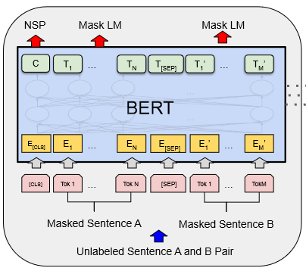
NSP allows for BERT learns the relationship between sentences
MLM is how BERT able to utilize bidirectional learning
BERT uses a special classification “CLS” and separation “SEP” tokens
The pre-training framework involves corpuses being applied to two tasks in equal measure

Slide 22
BERT: Pre-training of Deep Bidirectional Transformers for
Language Understanding
2019
Situations With Adversarial Generations / SWAG
The evaluation methods consisted of various tests
General Language Understanding Evaluation / GLUE benchmark
The Stanford Question Answering Dataset / SQuAD

Slide 23
2017
BART : Bidirectional and Auto-Regressive Transformers
But uses cross attention to enhance decoder based on encoder output
BART uses a base transformer architecture
Similar to BERT in that it incorporates bidirectional learning
Also omits the last feed forward neural network

Slide 24
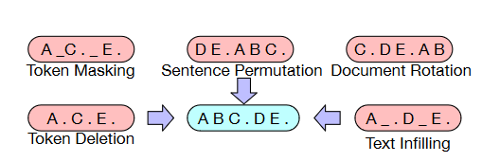
Pre-training of the BART model was done using text from Wikipedia and select books
The text is first transformed using various methods
Each attempts to “teach” the model differently

Slide 25
BART has been evaluated on several tasks, including SQuAD and some GLUE benchmarks
However, it is prone to overfitting on translation tasks
Outperforms other models on generative tasks
Also surpasses other models on Abstractive Question answering

Slide 26
PEGASUS: Pre-training with Extracted Gap-sentences for
Abstractive Summarization
2020
Its main usage is meant for abstractive text summarization
Masks entire sentences as opposed to a masking a sequence of words within a sentence
Also built on the base transformer architecture, but it aims to improve on the BART model in the realm of pre-training and masking

Slide 27
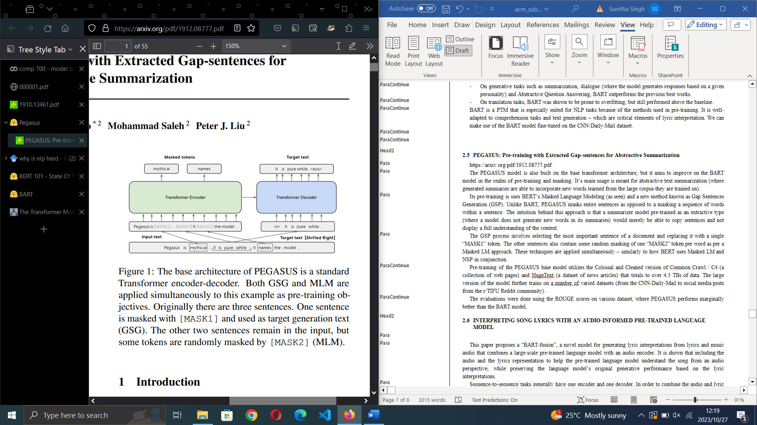
GSP process involves selecting the most important sentence of a document and replacing it with a single “MASK1” token
MLM is utilized as with BERT model
The PEGASUS large model features more than double the amount of training parameters and further trains on several varied datasets
Like BERT, pre-training framework involves gigantic text corpuses being applied to two tasks in equal measure.

Slide 28
“Collectively” : PEGASUS models trained on different datasets each achieved SOTA results in different tasks
The evaluations consisted of using ROUGE metrics.
Collectively, the large models outperformed the previous SOTA models.

Slide 29
2022
BART-fusion
which uses a linguistic PTM and audio samples from a song
Only other paper to have attempted the task of lyric interpretation
Utilizes a linguistic PTM and audio samples from a song

Slide 30
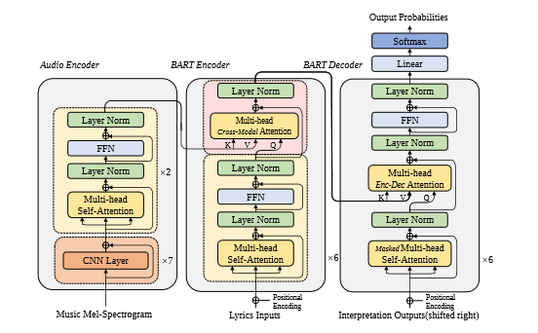
It can extract the audio features using a CNN and incorporates a multi-head attention sub-layer similar to the base transformer architecture
A second encoder is added to the traditional transformer model.
It differs in that it features multi-head “cross-attention”. Which is calculated the same as self-attention, but it can combine two different input sequences (i.e.: the audio and lyrics).

Slide 31
For evaluation, their BART-fusion model was compared to and outperformed the baseline BART model on the ROUGE and METEOR metrics and more or less matched it on the BERT-score.
The other important contribution of this paper is their impressive “Song Interpretation Dataset”.
It has been noted that when the lyrics revolve around difficult subjects that carry complex undertones, both models fail to generate a real, analytical interpretation.
It contains the audio and lyrics of over 20,000 songs from a variety of genres and almost half a million human interpretations.

Slide 32

Have these achievements come at a price ?
In our quest to push the boundaries of machine learning, it's essential to pause and consider the implications of our work
Many of them have advocated for world leaders to be sent up, because, from the perspective of our daily lives, we hardly think about the Earth really is

Slide 33

Have these achievements come at a price ?
In our quest to push the boundaries of machine learning, it's essential to pause and consider the implications of our work
Many of them have advocated for world leaders to be sent up, because, from the perspective of our daily lives, we hardly think about the Earth really is

Slide 34

Have these achievements come at a price ?
In our quest to push the boundaries of machine learning, it's essential to pause and consider the implications of our work
Many of them have advocated for world leaders to be sent up, because, from the perspective of our daily lives, we hardly think about the Earth really is

Slide 35

What can we do about it?
Leverage the concept of transfer learning
Utilize Pre-trained Models, which allow for:
Fewer training epochs
Data efficiency
Reduced hardware demands

Slide 36


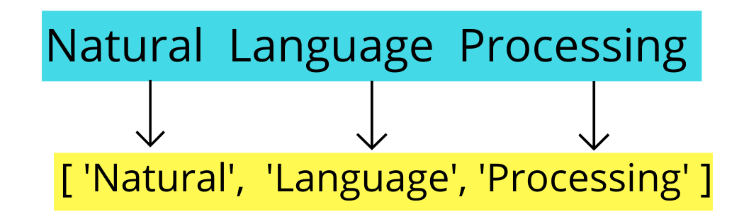



Implementation

Slide 37
Implementation
Leveraging PTM’s:
I've chosen to utilize the Hugging Face platform for accessing pre-trained models
It offers a framework for training and deploying models
Hugging Face fosters a collaborative and open-source ethos

Slide 38
Implementation
Software and Environment:
The heart of this project is Python and the Google Colab environment.
Decision between PyTorch and TensorFlow ML libraries was influenced by practical considerations
Moreover, TensorFlow’s support for Accelerated Linear Algebra (XLA) significantly accelerates the compilation of our transformer models..

Slide 39
Implementation
Harnessing the tokenizers:
Use PEGASUS and BART tokenizers.
The are used to process our dataset in conjunction with a data collator
We use a batch size of 2.

Slide 40
Implementation
Fine tuning for precision:
Deploy an AdaFactor optimizer employing a custom learning rate scheduler.
Each model undergoes a 10-epoch training cycle.
Hugging Face allows us to use a unique type of callback.

Slide 41
Implementation
Testing the waters:
Use the first 100 lyric-interpretation pairs from the test set of the Song Interpretation Dataset.
This testing environment eliminates any chances of data leakage
To generate the predictions, we again employ an XLA function.

Slide 42
Implementation
Evaluation metrics:
ROUGE - This set of metrics measure the amount of critical information retained in the generated summary when compared to a human based one.
METEROR - used for evaluating machine translation based on the idea of unigram/singular-word matching.
BERTScore - provide an insight into as to the semantic similarity of the sentences.

Slide 43
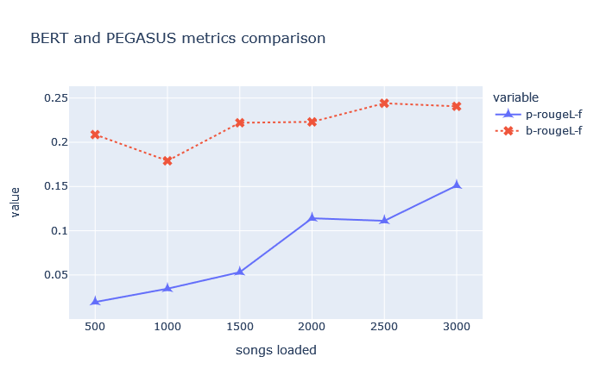
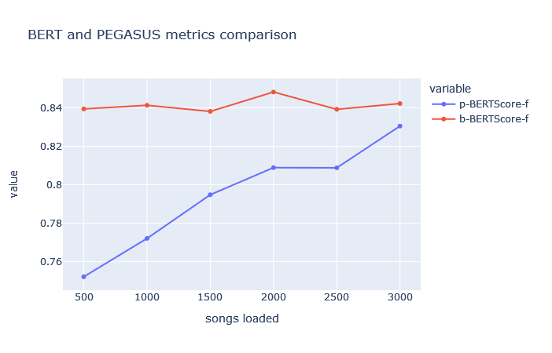
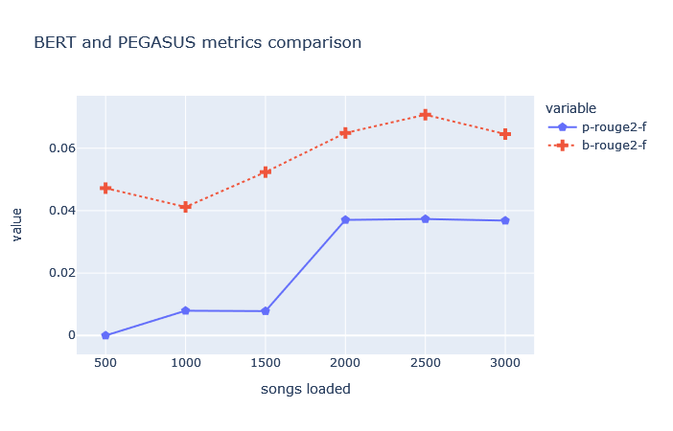
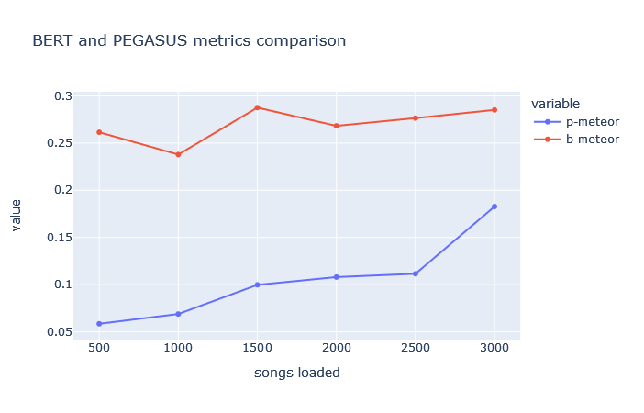
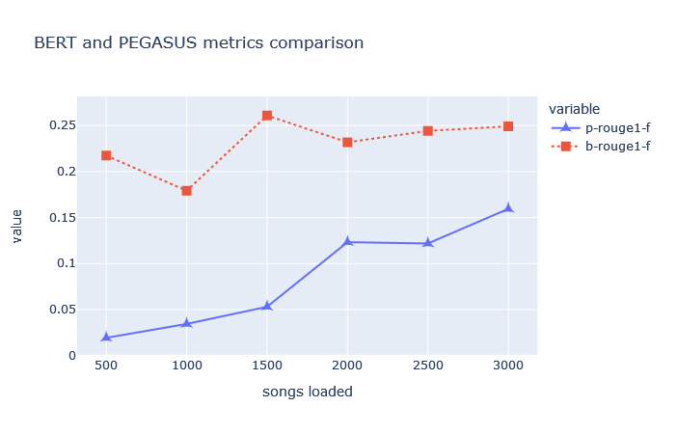
Results
Metrics
Extrapolation
Conclusion
BART-fusion achieved : 46.1

Slide 44
Results
Metrics
Extrapolation
Conclusion
BART-fusion achieved : 15.0

Slide 45
Results
Metrics
Extrapolation
Conclusion
BART-fusion achieved : 25.1

Slide 46
Results
Metrics
Extrapolation
Conclusion
BART-fusion achieved : 23.0

Slide 47
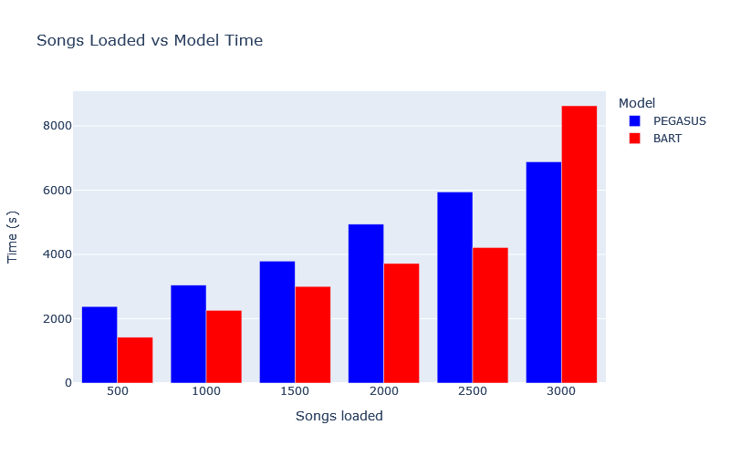
Results
Metrics
Extrapolation
Conclusion
BART-fusion achieved : 83.5

Slide 48
Results
Metrics
Extrapolation
Conclusion

Slide 49
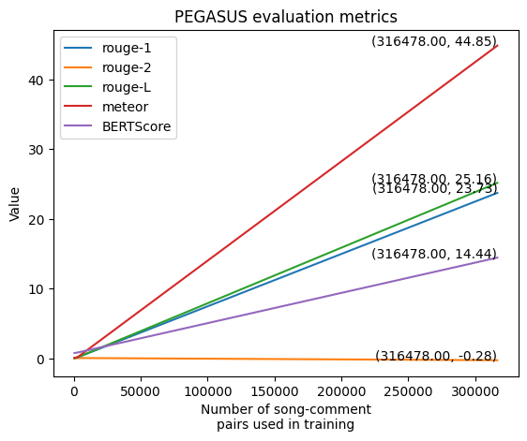
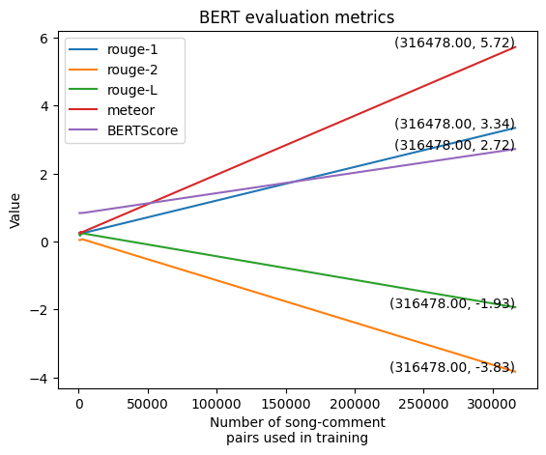
Results
As hypothesized, we can notice a steady increase in the metrics as more data is fed into the models.
The data has a linear relationship between the number of songs loaded and the metrics.
If we perform extrapolation to find the values when the full dataset is loaded, we get:
Metrics
Extrapolation
Conclusion
PEGASUS
BART

Slide 50
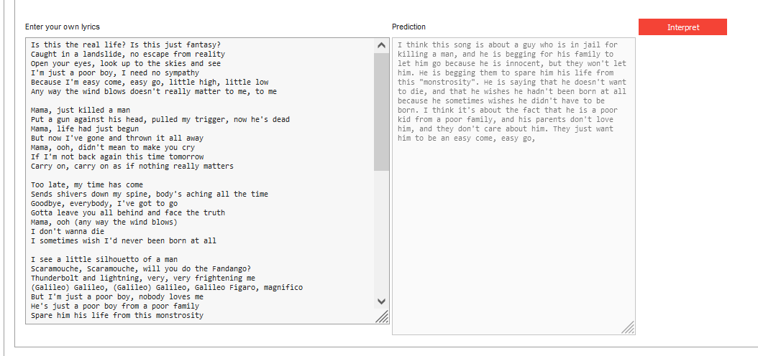
Results
The field of song lyric analysis is a challenging one, and as a lone explorer with limited resources, we faced formidable obstacles.
Our journey is far from over, and our current findings pave the way for future improvements and accomplishments.
All this was not for nothing, as the model is capable of making above average predictions. The following was the output for Bohemian Rhapsody:
Metrics
Extrapolation
Conclusion

Slide 51

Future work
Incorporate Artist and Context Data: Expand the dataset to include information about the song's artist(s) and the historical context in which it was written.
Experiment with Diverse Pre-trained Models: Given more substantial computing resources, experiment with pre-trained models
Enhanced Dataset Quality: Improve the dataset quality by curating interpretations that provide in-depth analysis similar to the scholarly study of poetry.
Feature Extraction: Implement feature extraction from song lyrics, including rhyme structures, orientation, and other linguistic elements, to enhance model understanding.

Slide 52
Future work
Incorporate Artist and Context Data: Expand the dataset to include information about the song's artist(s) and the historical context in which it was written.
Feature Extraction: Implement feature extraction from song lyrics, including rhyme structures, orientation, and other linguistic elements, to enhance model understanding.
Experiment with Diverse Pre-trained Models: Given more substantial computing resources, experiment with pre-trained models
Enhanced Dataset Quality: Improve the dataset quality by curating interpretations that provide in-depth analysis similar to the scholarly study of poetry.

Slide 53
Future work
Incorporate Artist and Context Data: Expand the dataset to include information about the song's artist(s) and the historical context in which it was written.
Experiment with Diverse Pre-trained Models: Given more substantial computing resources, experiment with pre-trained models
Enhanced Dataset Quality: Improve the dataset quality by curating interpretations that provide in-depth analysis similar to the scholarly study of poetry.
Feature Extraction: Implement feature extraction from song lyrics, including rhyme structures, orientation, and other linguistic elements, to enhance model understanding.

Slide 54
Future work
Experiment with Diverse Pre-trained Models: Given more substantial computing resources, experiment with pre-trained models
Enhanced Dataset Quality: Improve the dataset quality by curating interpretations that provide in-depth analysis similar to the scholarly study of poetry.
Feature Extraction: Implement feature extraction from song lyrics, including rhyme structures, orientation, and other linguistic elements, to enhance model understanding.
Incorporate Artist and Context Data: Expand the dataset to include information about the song's artist(s) and the historical context in which it was written.

Slide 55
Future work
Enhanced Dataset Quality: Improve the dataset quality by curating interpretations that provide in-depth analysis similar to the scholarly study of poetry.
Feature Extraction: Implement feature extraction from song lyrics, including rhyme structures, orientation, and other linguistic elements, to enhance model understanding.
Incorporate Artist and Context Data: Expand the dataset to include information about the song's artist(s) and the historical context in which it was written.
Experiment with Diverse Pre-trained Models: Given more substantial computing resources, experiment with pre-trained models

